Slide 1

Class 7 - Classes
[W200] MIDS Python

Slide 2
Course Content | moving into OOP
Unit 1 | Introduction, the Command Line, Source Control
Unit 2 | Starting Out with Python
Unit 3 | Sequence Types and Dictionaries
Unit 4 | More About Control and Algorithms
Unit 5 | Functions
Unit 6 | Modules and Packages
Unit 7 | Classes
Unit 8 | Object-Oriented Programming

Slide 3
Week 7 | Agenda
Homework Review and Admin Project 1 Proposal Classes (Objects) Structure and Purpose Attributes and Methods Initialization (and “self”) Getters, Setters and Decorators Project 1 Breakout and Recap
Midterm review (10% of grade)

Slide 4
Mid Semester Survey!
These surveys are a way you as students can give direct feedback to the administration and instructors.
We read each one and change the course based on your comments!
Examples of changes that came about because of student feedback:
Hiring a TA!
Ensuring grading and feedback is given in a timely manner
Course structure and lecture areas (numpy & pandas)
SURVEY LINK:
Posted in chat!

Slide 5
Assignment Review | Week 6
Refresher:
Pseudocode for scrabble?
Scrabble implementation
PEP 8 reading

Slide 6
Week 7 | Polls
Discuss: What was the hardest part of HW6?
Poll: How long did you spend on this week’s assignment?
Poll: what were your times for the scrabble assignment

Slide 7
Homework 5 Grading
Overall: Good work!
Printing inside functions:
Generally not done - functions should return the answer rather than print from inside.
Reasoning: The user can’t turn the printing off or modify the output if they want to print something different. If the function returns the value the user/programmer can decide how to use it.
One way to do both - make a Flag for the printing (some functions use a verbose flag as an argument to signal if the user wants the printing to happen or not)
If you printed inside a function for scrabble homework - don’t worry about changing it but keep it in mind for future functions!

Slide 8
Homework 5 Grading
Error checking inside functions:
Also usually not done; functions have docstring comments that tell a programmer what inputs the function requires.
Functions are used by programmers; there is some expectation that a programmer will be able to read the docstring and figure out what to send to a function.
Reasoning: Error checking on every argument on every function adds a lot of lines of code + processing time.
BL: Need to error check a user’s inputs but generally not a programmers.

Slide 9
Homework 7: Classes
There are 3 programming questions:
Deck of Cards, Galton’s Box, Sorting Marbles
Please do any 2 of the 3

Slide 10
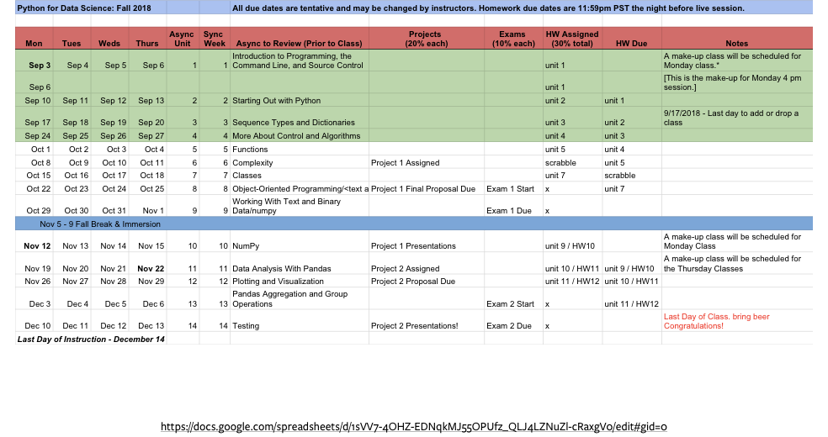

Slide 11
Week 7 | Agenda
Homework Review and Admin Project 1 Proposal Classes (Objects) Structure and Purpose Attributes and Methods Initialization (and “self”) Getters, Setters and Decorators Project 1 Breakout and Recap
Midterm review (10% of grade)

Slide 12
The Project | Proposal (Due before next class)
Describe your project concept
Pseudocode your major classes and functions
Briefly describe the purpose of each class
List expected functions belong to each class
List inputs and outputs for each function
Instructors will “approve” your draft proposal
Coding is iterative. Your final code may not match the proposal exactly

Slide 13
Week 7 | Agenda
Homework Review and Admin Project 1 Proposal Classes (Objects) Structure and Purpose Attributes and Methods Initialization (and “self”) Getters, Setters and Decorators Project 1 Breakout and Recap
Midterm review (10% of grade)

Slide 14
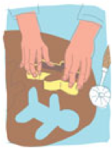
Classes (types) | ready to go vs custom
We are familiar with base python classes:
ints and strs, to lists, sets and dicts.
What are Classes?
Templates conferring a shared form
Instantiation uses a class definition to make a distinct object
Objects of a common class(type) contain distinct data

Slide 15
Classes | ready to go vs custom
Why create your own types?
Keep the “data” (attributes) with the “functions” (methods)
Extend the language
Can be tailored to hold new data or execute new tasks
Don’t just store data – objects interact:
Execute internal functions (class methods)
Manage other objects (Creation, Modification, Execution, Interaction)

Slide 16
Classes: data & functions
Classes: sending messages to each other

Slide 17
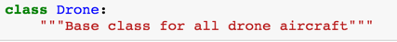
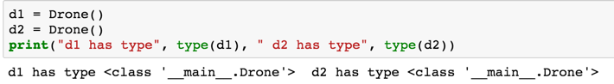
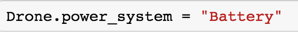

Class construction | the basics
Now we can form a base class
Instantiate individual objects from the base
Modify attributes for all instances
Modify attributes of individual instances
Notice the “Drone.power_system” versus the d1.power_system

Slide 18
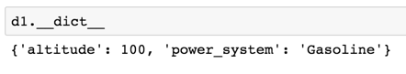
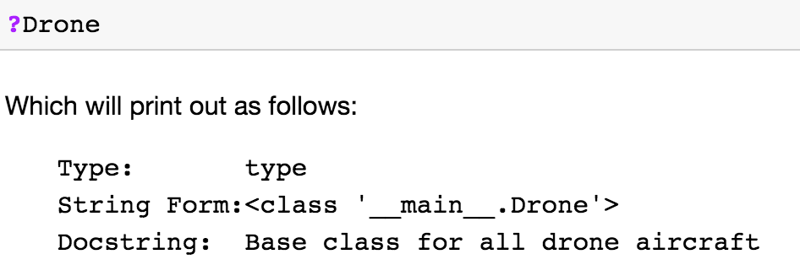
Class information |
dir(d1) # class methods
d1.__dict__ # attribute information
?Drone # class documentation

Slide 19
Week 7 | Agenda
Homework Review and Admin Project 1 Proposal Classes (Objects) Structure and Purpose Attributes and Methods Initialization (and “self”) Getters, Setters and Decorators Project 1 Breakout and Recap
Midterm review (10% of grade)

Slide 20
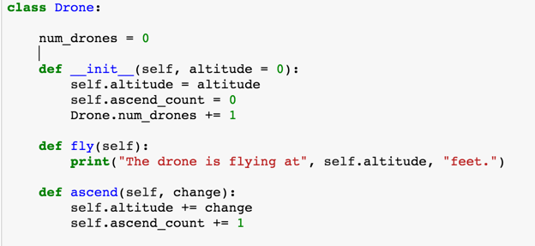
Attributes | class vs. individual
Class Attribute
Instance Attribute

Slide 21
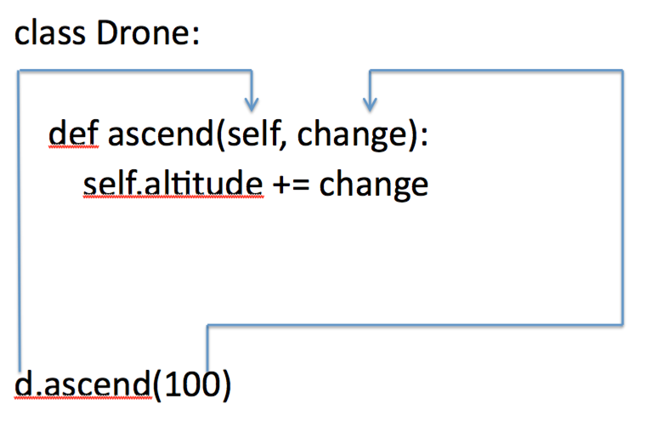
Methods | class-specific functions
The method “ascend” is a like a function bound to objects of the class Drone
You call ascend on instance d, a type Drone object
The first argument (self) is required and binds the method and result to the instance d

Slide 22
Week 7 | Agenda
Homework Review and Admin Project 1 Proposal Classes (Objects) Structure and Purpose Attributes and Methods Initialization (and “self”) Getters, Setters and Decorators Project 1 Breakout and Recap

Slide 23
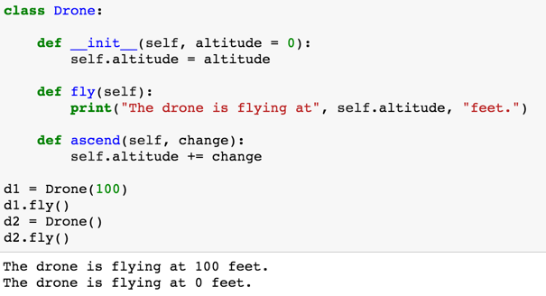
Initialize | require attributes at instantiation
Instantiation runs the __init__ method
Altitude is established at initialization and has a default value

Slide 24
Week 7 | Agenda
Homework Review and Admin Project 1 Proposal Classes (Objects) Structure and Purpose Attributes and Methods Initialization (and “self”) Getters, Setters and Decorators Project 1 Breakout and Recap

Slide 25
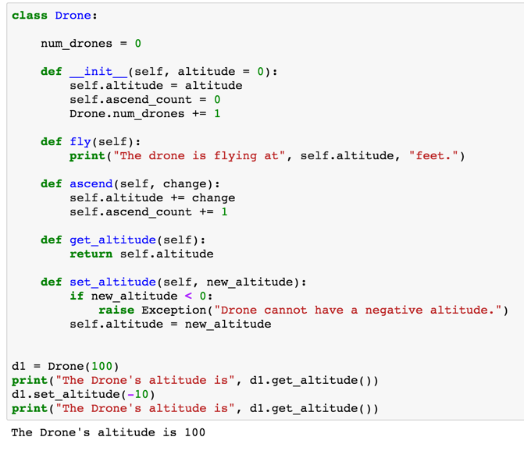
Get and set | require attributes at instantiation
More explicit than direct attribute access
We can add code into the get and set method
Direct a attribute specification
Using get and set for attributes

Slide 26
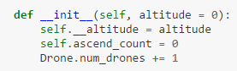
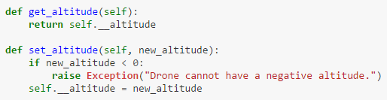
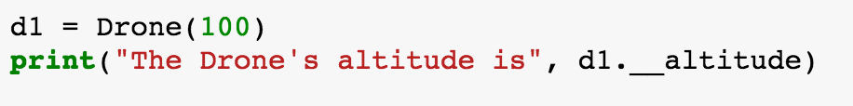
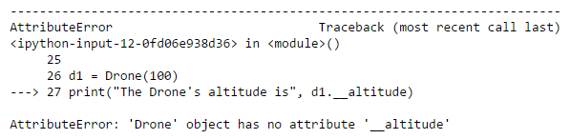
Hidden names | access, modify
You can use the “__” prefix to “require” programmers to use your setter and getter methods
It uses set_altitude automatically
They can override it via: d1._Drone__altitude

Slide 27
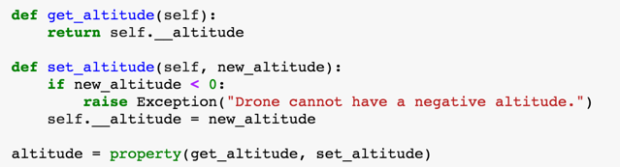
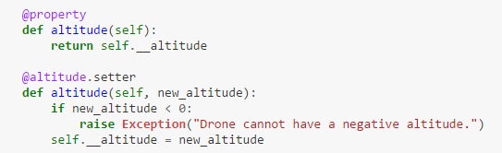
Properties and decorators |
Properties allow you to apply a setter and getter “after the fact”
Decorators start with @ and flag certain functions. You can use them to flag properties.
“set” is implicit

Slide 28
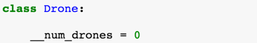
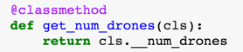
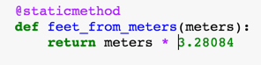
Other method types | declared with decorators
These decorators don’t do anything except tell us what to expect from the method
Class methods affect class - level attributes
Static methods do not affect attributes

Slide 29
Week 7 | Agenda
Homework Review and Admin Project 1 Proposal Classes (Objects) Structure and Purpose Attributes and Methods Initialization (and “self”) Getters, Setters and Decorators Project 1 Breakout and Recap

Slide 30
Class | A quick discussion
You will learn about “Inheritance” and “Polymorphism” this week. The plan you’ve created today may need to be modified to take advantage of these two concepts.
Inheritance - Allows a “child” class to inherit attributes and functions from a “parent” class. The child class can be customized, but you can change all children classes at once by modifying the parent.
Polymorphism - Allows a function to work on multiple types of object. Different classes can share the same interface, which allows a single function to accept multiple types of object.

Slide 31
Class | Breakout 1 discuss your plan in words
Read the the first part of this:
http://web.archive.org/web/20160816041541/http://learnpythonthehardway.org/book/ex43.html
Think of your classes;
objects as nouns
methods as verbs
How will objects interact

Slide 32
Class | Breakout 1 discuss your plan in words
Think about managing classes:
Do you need classes that organize / score object interactions?
(e.g., a ‘battle engine’ object? A ‘scoreboard’ object?)
Think about your user:
What will they be tasked with
What data will they be able to get
Critique, question, respond ...

Slide 33
The Project | Your Mission
Create a small, object-oriented program of your choosing:
Examples:
An ATM
A flower shop
An adventure game
Something relating to your everyday work

Slide 34
The Project | Code
Python 3 code, 300-500 lines (750 max)
All code should be well commented!
Must use Object Oriented design and classes (OOD, OOP)
Demonstrate various control-of-flow statements & data types
Robust to common user errors and exceptions

Slide 35
The Project | Your Mission
The user will interact with your program via Terminal/Shell
Three documents due before your class on 3/13 or 3/15:
Proposal (10%)
Code(s) (80%)
Reflective Summary (10%)
You will demo your progress in a breakout room
Please only use Python libraries that come installed with Anaconda

Slide 36

The Project | Proposal
Describe your project concept
Pseudocode your major classes and functions
Briefly describe the purpose of each class
List expected functions belong to each class
List inputs and outputs for each function
Instructors will “approve” your draft proposal
Coding is iterative. Your final code may not match the proposal exactly

Slide 37
The Midterm | Content
All work done in a Jupyter Notebook
Covers Units 1 - 6
Many questions are theory based (short answer)
Also some coding problems
Designed to be completed in a couple of hours

Slide 38
The Project | Questions

Slide 39
The Project | Reflection
Submit a 1-page reflection with your code
Instructors will read your reflection before grading your project
Tell us how to use your project!
Discuss challenges you faced and how you overcame them

Slide 40
The Project | Demo
As time allows, show 1-2 examples of strong projects from last semester.
Good luck!

Slide 41
Midterm Review
Live Q & A using Poll Features
Notes:
Review
Shell Scripting
cd, ls, pwd, touch, mkdir, rmdir
Create a new .txt file with "hello" in it
Why careful with rmdir?
Git and Source Control
Difference between git and github
Initialize a blank repository
Add, remove, add, commit
GitHub
How do you pull from github (playground)
How do you pull from github (self)
Go to private repo and mkdir pirate
Put a text file that has a pirate sound.
Commit and push
--
Python from the Command Line
How to do it?
Create a variable called "moo" equal to your favorite number. Math. Remainder
Prompt user for input, save it.
Python from a .py File
Juypter Notebooks
---
Variables
Operations
Strings
---
Lists
Ranges
Tuples
Dictionaries
Mutability
---
If, Elif, Else
For and While loops
Comprehensions
Breaking out of Loops
Try / Except
---
Functions
Namespaces (and Parameters)
The Stack
Exceptions

